Slide 1
COMP 1111 – Week 3
Database Fundamentals
John Holmes, Mark Coulas, Troy St. Jean

Slide 2
Lab Feedback
Please take 2 minutes to complete this anonymous lab feedback so that we can make your lab experience better:
Anonymous Survey

Slide 3
House Keeping
Scholarships and Bursaries
Apple Update
O365 Profile Photo
Blackboard Photo

Slide 4
Learning Objectives
Understand:
the nature and characteristics of databases
the potential problems with lists
the reasons for using a database
how using related tables helps you avoid the problems of using lists

Slide 5
What is a database?
Take a moment to write what you believe a database is.
What is a database management system?
Take a moment to write what you believe a DBMS is.

Slide 6
What is a database?
In computing, a database is an organized collection of data stored and accessed electronically through the use of a database management system. Small databases can be stored on a file system, while large databases are hosted on computer clusters or cloud storage. Wikipedia

Slide 7
Why Use a Database?
Understand the nature and characteristics of databases
The reason databases are used is to keep track of things.
Databases store more complicated information than simple lists like a spreadsheet.

Slide 8
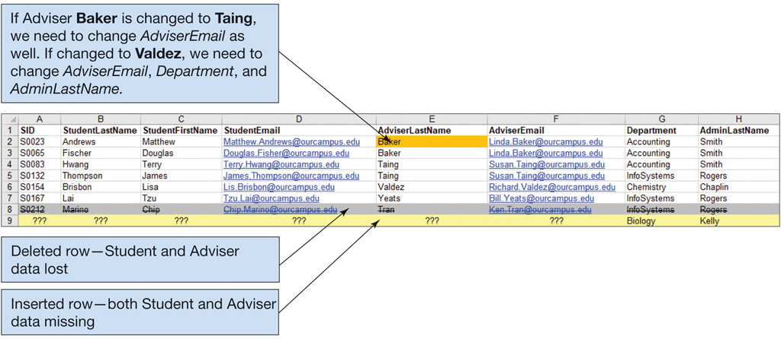
Figure 1.7 The Student with Advisor and Department List
Understand the potential problems with lists
A major problem with using lists include:
Modification problems: Redundancy and multiple "themes" can create modification problems such as deleting, updating, and inserting records as seen in the figure below.
Excel 2019, Windows 10, Microsoft Corporation.

Slide 10
Using Relational Database Tables
Understand how using related tables helps you avoid the problems of using lists.
Relational model is a methodology used as a solution for database design.
A relational database contains a collection of separate tables.
A table holds data about only one theme.
Each column, also known as fields, in a table stores a characteristic common to all rows in a table. An example is StudentNumber.
A row in a table, also known as a record, has data about an occurrence. An example would be all the information on one student.

Slide 12
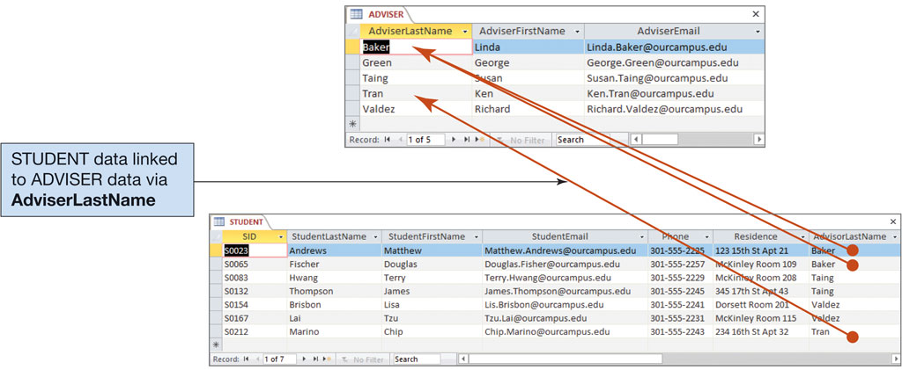
Figure 1.8 The Advisor and Student Tables
Access 2019, Windows 10, Microsoft Corporation.

Slide 13
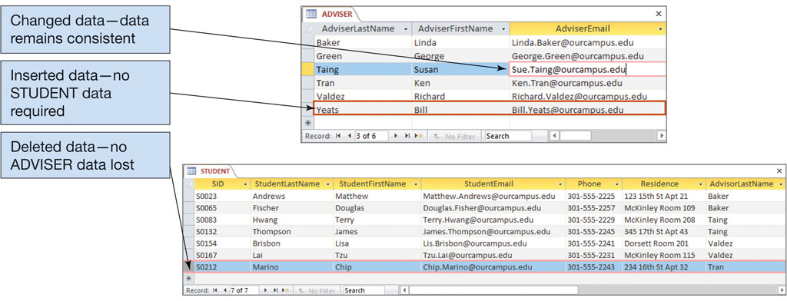
Figure 1.9 Modifying the Advisor and Student Tables
Access 2019, Windows 10, Microsoft Corporation.

Slide 14
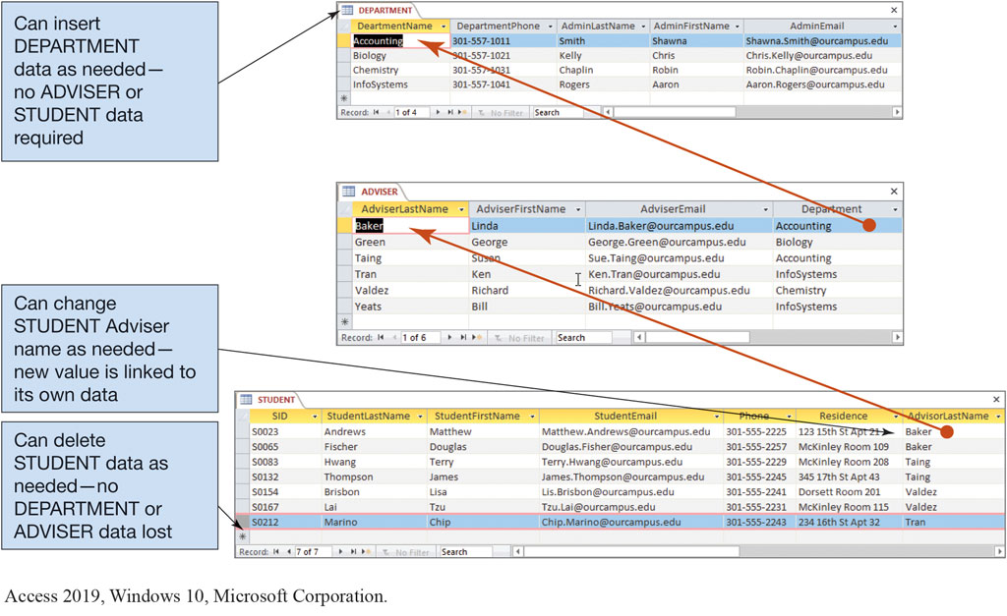
Figure 1.10 The Department, Advisor, and Student Tables

Slide 15
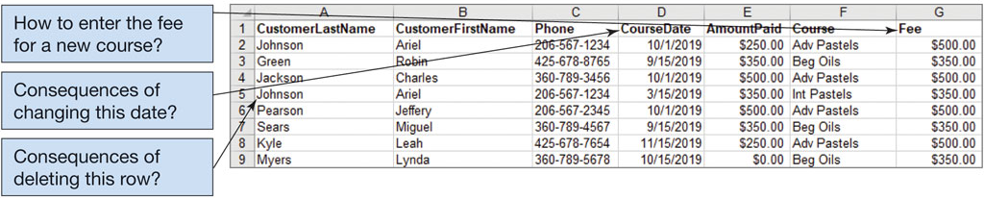
Figure 1.11 The Art Course List with Modification Problems
Excel 2019, Windows 10, Microsoft Corporation.

Slide 16
Figure 1.11 The Art Course List with Modification Problems
How many themes are in this list?
Excel 2019, Windows 10, Microsoft Corporation.

Slide 17
Figure 1.11 The Art Course List with Modification Problems
What would the names of these three themes/tables be?
Excel 2019, Windows 10, Microsoft Corporation.

Slide 18
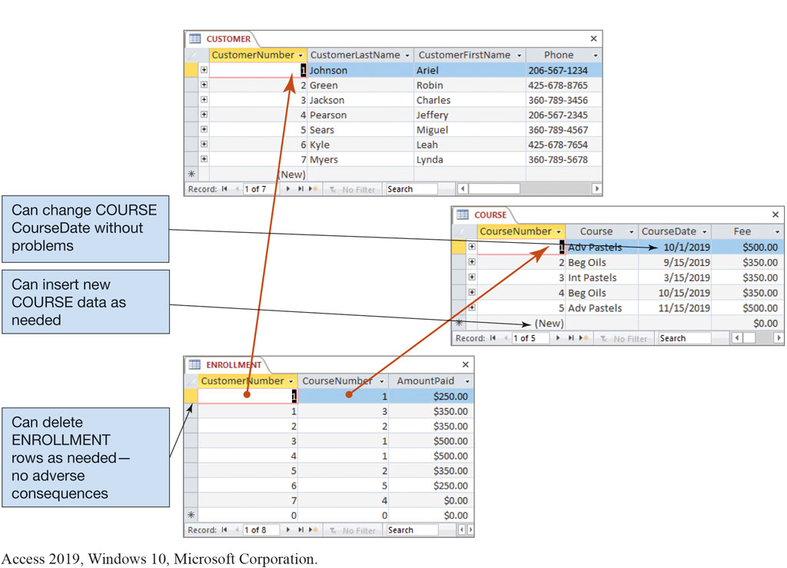
Figure 1.12 The Art Course Database Tables

Slide 19
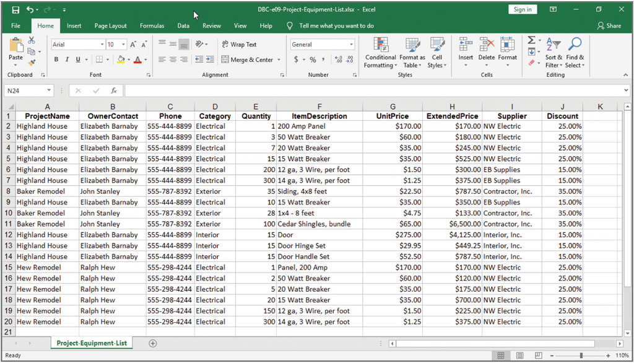
Figure 1.13 The Project Equipment List as a Spreadsheet

Slide 20
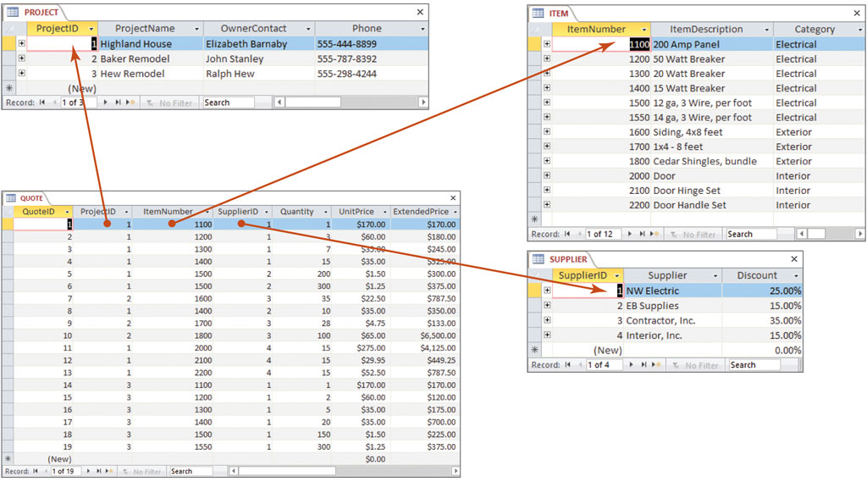
Figure 1.14 The Project Equipment Database Tables

Slide 21
How do I Process Relational Tables Using S Q L?
The leading technique for data definition and manipulation is Structured Query Language (S Q L).
S Q L is an international standard for creating, processing, and querying databases and their tables.
Using S Q L you can:
Reconstruct lists from their underlying tables,
Query for specific data conditions,
Perform calculations on data in tables, and
Insert, update, and delete data.

Slide 22
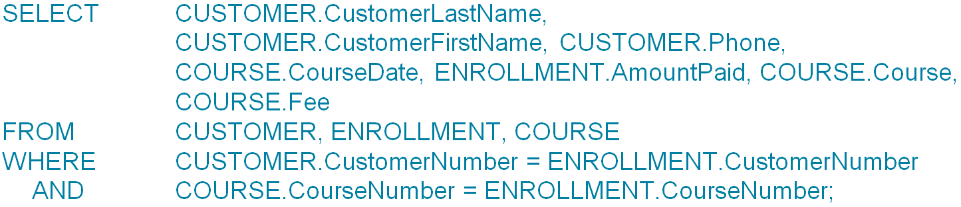
S Q L Art Course Database Example
Understand how using related tables helps you avoid the problems of using lists
Using S Q L, the following code will combine the three tables in the Art Course Database as seen in Figure 1.12:
The results of running the code above can be seen in Figure 1.15 on the next page.

Slide 23
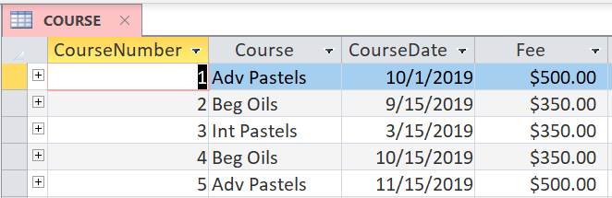
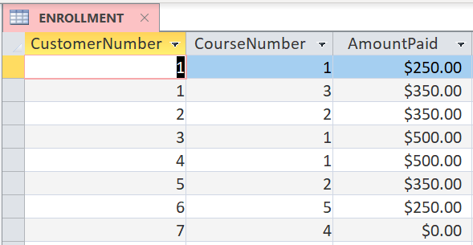
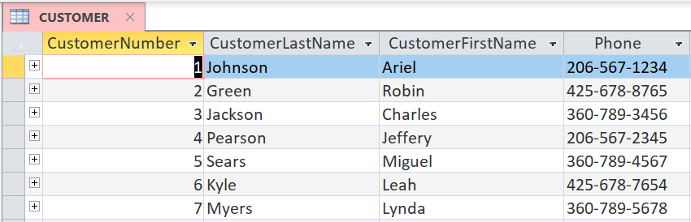
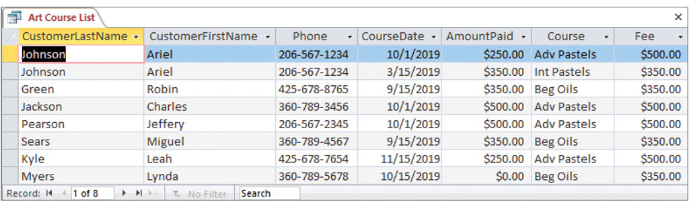
Figure 1.15 Results of the S Q L Query to Recreate the Art Course List Data

